Slide 1
Computer graphics III –
Rendering equation and its solution
Jaroslav Křivánek, MFF UK
Jaroslav.Krivanek@mff.cuni.cz

Slide 2
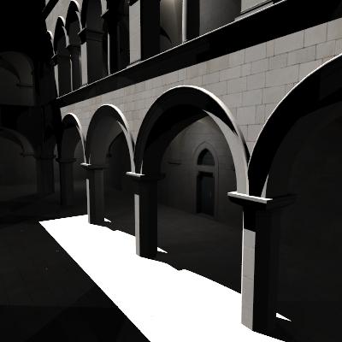
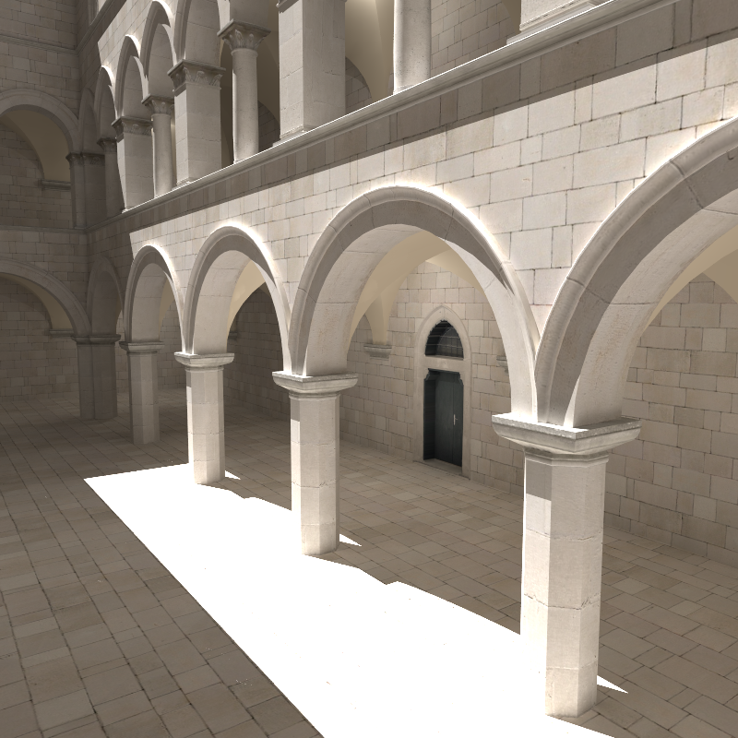
Global illumination – GI
Direct illumination
Global =
direct +
indirect
2

Slide 3
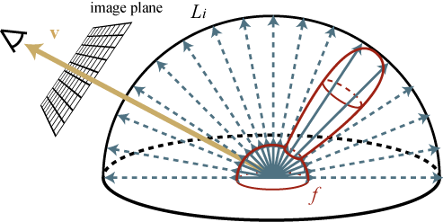
Review:
Reflection equation
“Sum” (integral) of contributions over the hemisphere:
n
L_{i}(x, ω_{i})
Emitted radiance
L_{o}(x, ω_{o})
dω_{i}
θ_{o}
θ_{i}
L_{r}(x, ω_{o})
Total outgoing rad.
Reflected rad.

Slide 4
From local reflection to global light transport
Reflection equation (local reflection)
Where does the incoming radiance L_{i}(x, ω_{i}) come from?
  From other places in the scene !
L_{o}( r(x, ω_{i}), -ω_{i})
r(x, ω_{i})
=
L_{i}(x,ω_{i})
x
Ray casting function

Slide 5
From local reflection to global light transport
Plug for L_{i} into the reflection equation
Incoming radiance L_{i} drops out
Outgoing radiance L_{o} at x described in terms of L_{o} at other points in the scene

Slide 6
Rendering equation
Remove the subscript “o” from the outgoing radiance:
Description of the steady state = energy balance in the scene
Rendering = calculate L(x, ω_{o}) for all points visible through pixels, such that it fulfils the rendering equation

Slide 7
Reflection equation vs.
Rendering equation
Similar form – different meaning
Reflection equation
  Describes local light reflection at a single point
  Integral that can be used to calculate the outgoing radiance if we know the incoming radiance
Rendering equation
  Condition on the global distribution of light in scene
  Integral equation – unknown quantity L on both sides

Slide 8
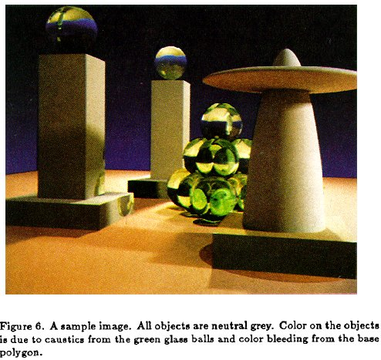
Rendering Equation – Kajiya 1986

Slide 9
Path tracing sketch

Slide 10

Recursive unwinding of the RE
Angular form of the RE
To calculate L(x, ω_{o}), we need to calculate L(r(x, ω’), −ω’) for all directions ω’ around the point x
For the calculation of each L(r(x, ω’), −ω’), we need to do the same thing recursively,
etc.
r( r(x,ω’), ω’)
ω’’
r(x, ω’)
ω’
ω_{o}
x

Slide 11
Path tracing, v. zero (recursive form)
getLi (x, ω):
y = traceRay(x, ω)
return
Le(y, –ω) + // emitted radiance
Lr (y, –ω) // reflected radiance
Lr(x, ω):
ω′ = genUniformHemisphereRandomDir( n(x) )
return 2π * brdf(x, ω, ω′) * dot(n(x), ω′) * getLi(x, ω′)

Slide 12
Back to the theory:
Angular and area form of the rendering equation

Slide 13
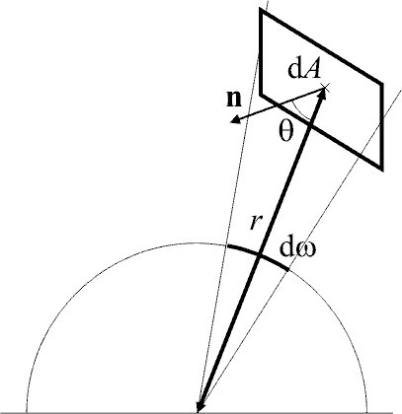
Angular vs. area form of the RE
Angular form
  integral over the hemisphere in incoming directions
Substitution

Slide 14
Angular vs. area form of the RE
Area form
  Integral over the scene surface
scene surface
visibility
1 … y visible from x
0 … otherwise
geometry term

Slide 15
Angular form
Add radiance contributions to a point from all directions
For each direction, find the nearest surface
Implementation in stochastic path tracing:
  For a given x, generate random direction(s), for each find the nearest intersection, return the outgoing radiance at that intersection and multiply it with the cosine-weighted BRDF. Average the result of this calculation over all the generated directions over the hemisphere.

Slide 16
Area form
Sum up contributions to a point from all other points on the scene surface
Contribution added only if the two points are mutually visible
Implementation in stochastic path tracing:
  Generate randomly point y on scene geometry. Test visibility between x and y. If mutually visible, add the outgoing radiance at y modulated by the geometry factor.
Typical use: direct illumination calculation for area light sources

Slide 17
Most rendering algorithms = (approximate) solution of the RE
Local illumination (OpenGL)
  Only point sources, integral becomes a sum
  Does not calculate equilibrium radiance, is not really a solution of the RE
Finite element methods (radiosity) [Goral, ’84]
  Discretize scene surface (finite elements)
  Disregard directionality of reflections: everything is assumed to be diffuse
  Cannot reproduce glossy reflections

Slide 18
Most rendering algorithms = (approximate) solution of the RE
Ray tracing [Whitted, ’80]
  Direct illumination on diffuse and glossy surfaces due to point sources
  Indirect illumination only on ideal mirror reflection / refractions
  Cannot calculate indirect illumination on diffuse and glossy scenes, soft shadows etc. …
Distributed ray tracing [Cook, ’84]
  Estimate the local reflection using the MC method
  Can calculate soft shadows, glossy reflections, camera defocus blur, etc.

Slide 19
Most rendering algorithms = (approximate) solution of the RE
Path tracing [Kajiya, ’86]
  True solution of the RE via the Monte Carlo method
  Tracing of random paths (random walks) from the camera
  Can calculate indirect illumination of higher order

Slide 20
From the rendering equation to finite element radiosity

Slide 21
From the rendering equation to radiosity
Start from the area form of the RE:
The Radiosity method– assumptions
  Only diffuse surfaces (BRDF constant in ω_{i} and ω_{o})
  Radiosity (i.e. radiant exitance) is spatially constant (flat) over the individual elements

Slide 22
From the rendering equation to radiosity
Diffuse surfaces only
  The BRDF is constant in ω_{i} and ω_{o}
  Outgoing radiance is independent of ω_{o} and it is equal to radiosity B divided by π

Slide 23
From the rendering equation to radiosity
Spatially constant (flat) radiosity B of the contributing surface elements
Radiosity of the j-th element
Geometry factor between
surface element j and point x

Slide 24
From the rendering equation to radiosity
Spatially constant (flat) radiosity of the receiving surface element i:
  Average radiosity over the element
… form factor

Slide 25
Classic radiosity equation
System of linear equations
Form factors
Conclusion: the radiosity method is nothing but a way to solve the RE under a specific set of assumptions

Slide 26
Radiosity method
Classical radiosity
  Form facto calculation (Monte Carlo, hemicube, …)
  Solve the linear system (Gathering, Shooting, …)
Stochastic radiosity
  Avoids explicit calculation of form factors
  Metoda Monte Carlo
Radiosity is not practical, not used
  Scene subdivision -> sensitive to the quality of the geometry model (but in reality, models are always broken)
  High memory consumption, complex implementation

Slide 27
The operator form of the RE

Slide 28
RE is a Fredhom integral equation of the 2nd kind
General form the Fredholm integral equation of the 2nd kind
Rendering equation:
unknown
function
known
functions
equation
“kernel”

Slide 29
Linear operators
Linear operators act on functions
  (as matrices act on vectors)
The operator is linear if the “acting” is a linear operation
Examples of linear operators

Slide 30
Transport operator
Rendering equation

Slide 31
Solution of the RE in the operator form
Rendering equation
Formal solution
  unusable in practice – the inverse cannot be explicitly calculated

Slide 32
Expansion of the rendering equation
Recursive substitution L
n-fold repetition yields the Neumann series

Slide 33
Expansion of the rendering equation
If T is a contraction (tj. ||T|| < 1, which holds for the RE), then
Solution of the rendering equation is then given by

Slide 34
A different derivation of the Neumann series
Formal solution of the rendering equation
Proposition
Proof

Slide 35
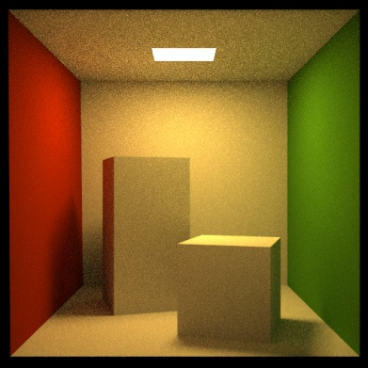

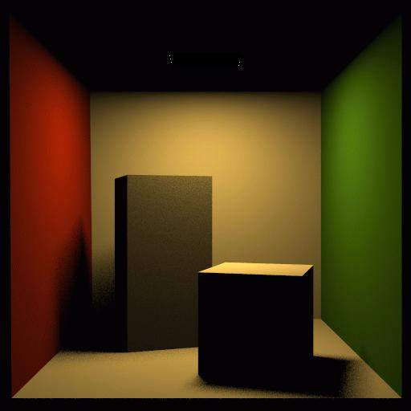
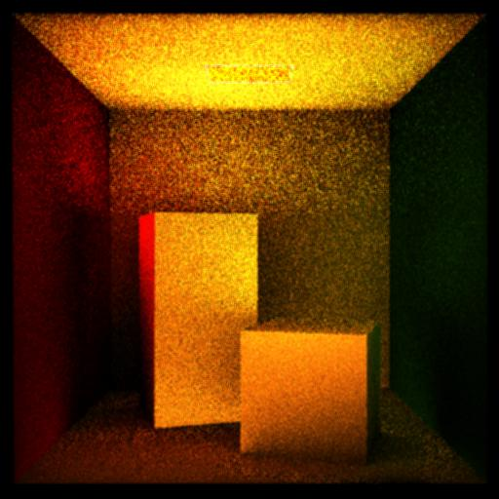
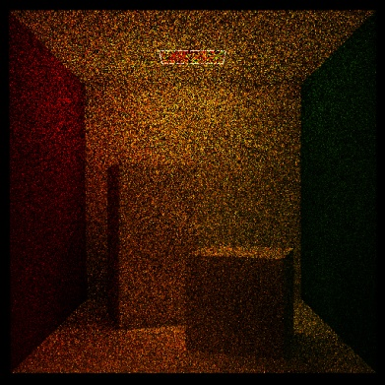
Rendering equation
Solution: Neumann series

Slide 36
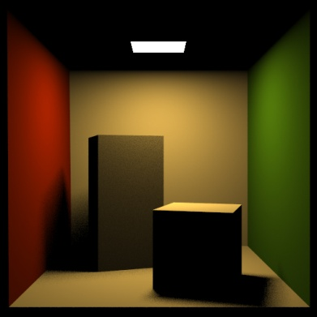
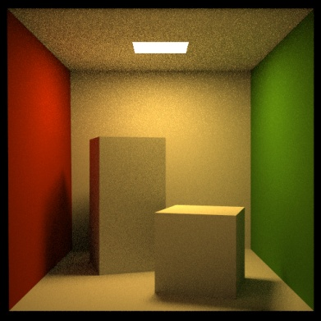
Progressive approximation

Slide 37
Progressive approximation
Each application of T corresponds to one step of reflection & light propagation
emission
one-bounce
indirect illumination
direct
illumination
two-bounce
indirect illumination
OpenGL shading

Slide 38
Contractivity of T
Holds for all physically correct models
  Follows from the conservation of energy
It means that repetitive application of the operator lower the remaining light energy (makes sense, since reflection/refraction cannot create energy)
Scenes with white or highly specular surfaces
  reflectivity close to 1
  to achieve convergence, we need to simulate more bounces of light

Slide 39
Alright, so what have we achieved?
Rendering
equation
Solution through the
Neumann series
We have replaced an integral equation by a sum of simple integrals
Great we know how to calculate integrals numerically (the Monte Carlo method), which means that we know how to solve the RE, and that means that we can render images, yay!
Recursive application to T corresponds to the recursive ray tracing from the camera

Slide 40
What exact integral are we evaluating, then?

Slide 41
Paths vs. recursion: Same thing, depends on how we look at it
Paths in a high-dimensional path space
Recursive solution of a series of nested (hemi)spherical integrals:

Slide 42
Recursive interpretation
We’ve seen this already, right?
But unlike at the beginning of
the lecture, by now we know this
actually solves the RE.
Angular form of the RE
To calculate L(x, ω_{o}) I need to calculate L(r(x, ω’), −ω’) for all directions ω’ around the point x.
For the calculation of each L(r(x, ω’), −ω’) I need to do the same thing recursively
etc.
r( r(x,ω’), ω’)
ω’’
r(x, ω’)
ω’
ω_{o}
x

Slide 43
Path tracing, v. zero (recursive form)
getLi (x, ω):
y = traceRay(x, ω)
return
Le(y, –ω) + // emitted radiance
Lr (y, –ω) // reflected radiance
Lr(x, ω):
ω′ = genUniformHemisphereRandomDir( n(x) )
return 2π * brdf(x, ω, ω′) * dot(n(x), ω′) * getLi(x, ω′)

Slide 44
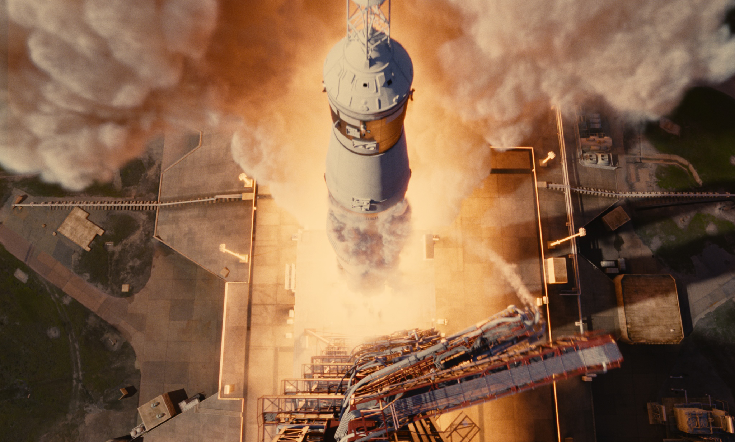
Path tracing, v. 2012, Arnold Renderer
© 2012 Columbia Pictures Industries, Inc. All Rights Reserved.

Slide 45


Notes:
Ale samozrejme nechceme nase know-how pouze vyvazet ven a proto jsme zalozili domaci firmu, ktera vyviji renderovaci software jmenem Corona Renderer.
Hlavnim vyvojarem a tahounem tohoto projektu je nas byvaly doktorand Ondra Karlik na teto fotce.

Slide 46
Path tracing [Kajiya86]
Only one secondary ray at each intersection
  Random selection of interaction (diffuse reflection, refraction, etc., …)
Direct illumination: two strategies
  Hope that the generated secondary ray hits the light source, or
  Explicitly pick a point on the light source
Trace hundreds of paths through each pixel and average the result
Advantage over distributed ray tracing: now branching of the ray tree means no explosion of the number of rays with recursion depth

